Slide 1
CSE 405
I/O Interfacing
Osama Hosameldeen
Spring 2021
Lecture 4: Sensors and interfacing

Slide 2
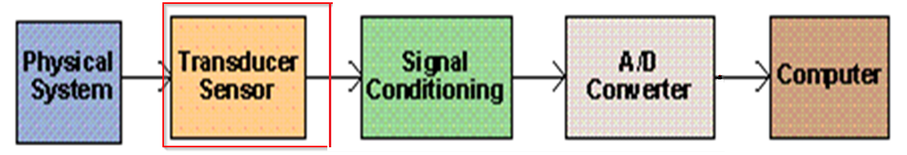
Contents
Introduction
Digital I/O Devices
Digital sensors for analog signals
Sensors and transducers
Wheatstone bridges
Thermocouples
Resistance Temperature Device (RTD)
All rights reserved. compiled by Dr. Osama Hosameldeen

Slide 3
Introduction
© 2015 ELSIVER, All rights reserved. compiled by Dr. Osama Hosameldeen

Slide 4

Signal types
Analog and Digital signals
© 2015 ELSIVER, All rights reserved. compiled by Dr. Osama Hosameldeen

Slide 5
Signal types
Digital signals, carry information only in their timing.
The frequency, duration, duty cycle or absolute number of pulses are generally the only significant characteristics of pulsed signals. Their amplitude does not carry any information.
Analogue signals carry information in their magnitude (level) or shape (variation over time). Most ‘real-world’ processes that we might wish to measure, or control are intrinsically analogue in nature.
© 2015 ELSIVER, All rights reserved. compiled by Dr. Osama Hosameldeen
Notes:
The duty cycle is defined as the ratio between the pulse duration, or pulse width and the period of a rectangular waveform
Duty cycle is percent of time that the signal stays at high level. It is typically expressed as the percentage of the period.
As an example, a 100MHz signal (100 million cycles per second) has a period of 10ns. If the signal has 5ns high and 5ns low period, the duty cycle of this signal is 50%. However, if the high signal is 3ns and low signal is 7ns, the duty cycle would be 30%.

Slide 6
Elements of a DA&C system
A typical PC-based DA&C system might be designed to accept analogue inputs from sensors as well as digital inputs from switches or counters.
It might also be capable of generating analogue and digital outputs for controlling actuators, lamps or relays.
Some devices maybe required, such as multiplexers, programmable-gain amplifiers and ADCs. (next slide)
© 2015 ELSIVER, All rights reserved. compiled by Dr. Osama Hosameldeen

Slide 7
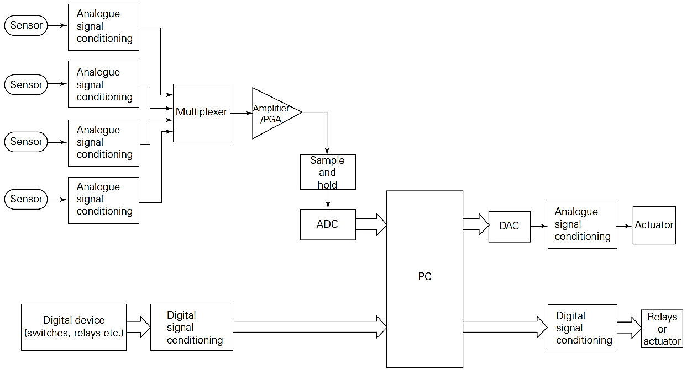
Elements of a DA&C system
© 2015 ELSIVER, All rights reserved. compiled by Dr. Osama Hosameldeen

Slide 8
Digital I/O Devices
© 2015 ELSIVER, All rights reserved. compiled by Dr. Osama Hosameldeen

Slide 9
TTL-level digital signals
Transistor–transistor logic (TTL) can work in high speed.
It can also be directly interfaced to the PC.
Drawbacks:
TTL ICs have a limited current capacity and are suitable for driving low current devices such as another TTL, LEDs or transistors.
It is ideal for communicating with devices on plug-in DA&C cards, it cannot be used for long-distance transmission
© 2015 ELSIVER, All rights reserved. compiled by Dr. Osama Hosameldeen

Slide 10
Opto-isolated I/O
Opto-isolators can provide isolation from typically 500 V to a few kV at frequencies up to several hundred kHz
consist of an infrared LED optically coupled to a phototransistor within a standard DIL (Dual-in-line) package
The digital signal is transferred from the input (LED) circuit to the output (phototransistor) by means of an infrared light beam (next slide)
© 2015 ELSIVER, All rights reserved. compiled by Dr. Osama Hosameldeen

Slide 11
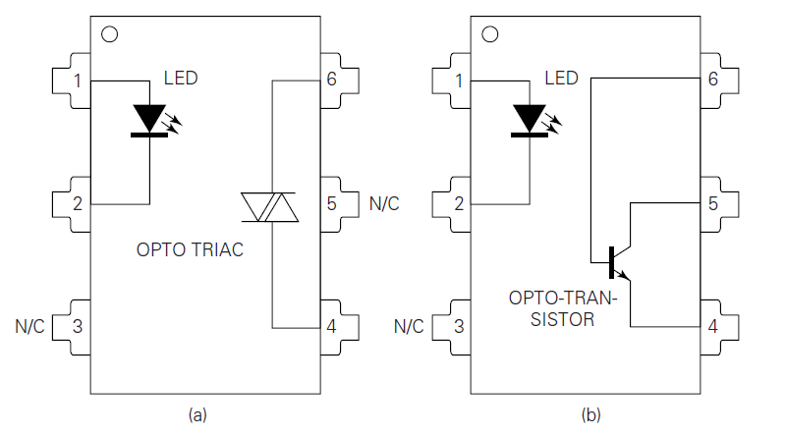
Opto-isolated I/O
Typical opto-isolator DIL packages: (a) an opto-triac suitable for mains switching, and (b) a simple opto-transistor device
© 2015 ELSIVER, All rights reserved. compiled by Dr. Osama Hosameldeen
Notes:
الترياك (TRIAC) هو مكون إلكتروني يستطيع تمرير التيار الكهربائي في الإتجاهين، وكلمة (TRIAC) هي عبارة عن الحروف الأولى من (Triode for Alternating Current) .
Mains is the main power which is 220 V

Slide 12
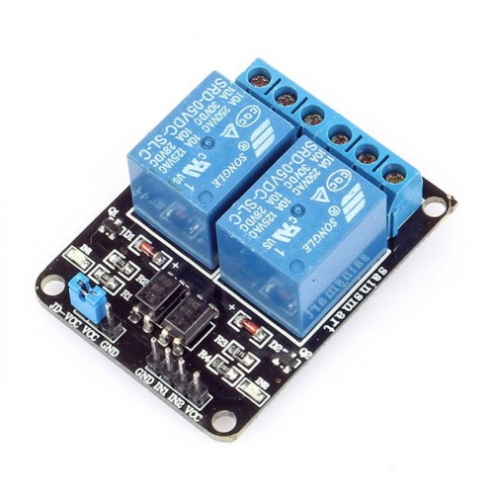
Mechanical relays and switches
Relays are electromechanical devices which permit electrical contacts to be opened or closed by small driving currents.
Relays are ideal for isolating high current devices, such as electric motors, from the PC and from sensitive electronic control circuits.
A number of manufacturers provide plug-in PC interface cards with typically 8 or 16 PCB-mounted relays.
© 2015 ELSIVER, All rights reserved. compiled by Dr. Osama Hosameldeen

Slide 13
Digital sensors for
analogue signals
© 2015 ELSIVER, All rights reserved. compiled by Dr. Osama Hosameldeen

Slide 14
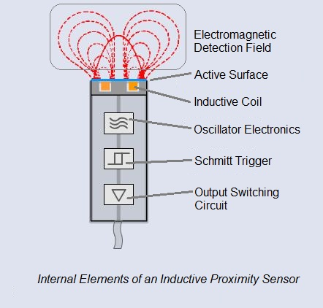
Digital sensors
Switch: Examples include inductive proximity switches and mechanical limit switches.
These produce a single-bit input which changes state when some physical parameter (e.g. spatial separation or displacement) rises above, or falls below, a predefined limit.
Such sensors are more correctly known as encoders as they are designed to encode the measurand into a digital form
© 2015 ELSIVER, All rights reserved. compiled by Dr. Osama Hosameldeen

Slide 15
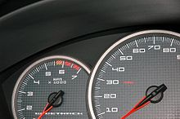
Digital sensors
Rotor tachometer: employ magnetic pickups which produce a stream of digital pulses in response to the rotation of a ferrous disk.
Angular velocity or incremental changes in angular position can be measured with these devices.
The pulse rate is proportional to the angular velocity of the disk.
Similar sensors are available for measuring linear motion.
© 2015 ELSIVER, All rights reserved. compiled by Dr. Osama Hosameldeen

Slide 16
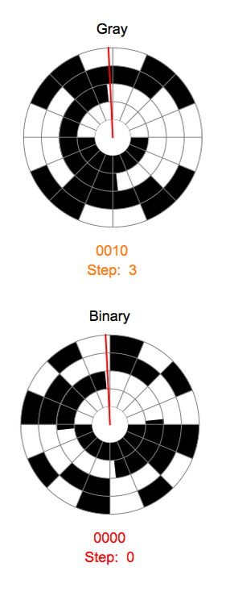
Digital sensors
Shaft encoders: used for rotary position
They consist of a binary encoded disk which is mounted on a rotating shaft or spindle and located between some form of optical transmitter and matched receiver (e.g. infrared LEDs and phototransistors).
The disk is encoded using the Gray code scheme. This a binary coding scheme in which only one bit changes between adjacent coded positions
© 2015 ELSIVER, All rights reserved. compiled by Dr. Osama Hosameldeen

Slide 17
Sensors and transducers
© 2017 Pearson Education, Ltd., All rights reserved. compiled by Dr. Osama Hosameldeen

Slide 18
Transducers
A transducer is a device that converts one form of energy or physical quantity into another, in accordance with some defined relationship.
Where a transducer is the sensing element that responds directly to the physical quantity to be measured and forms part of an instrumentation or control system, then the transducer is often referred to as a sensor
© 2017 Pearson Education, Ltd., All rights reserved. compiled by Dr. Osama Hosameldeen

Slide 19
Types of Transducers
Two defined categories of transducer exist:
Active transducers: convert non-electrical energy into an electrical output signal. Thermocouples are an example of an active transducer.
Passive transducers change an electrical network value, such as resistance, inductance or capacitance, according to changes in the physical quantity being measured. Strain gauges (resistive change to stress) is example of this type.
© 2017 Pearson Education, Ltd., All rights reserved. compiled by Dr. Osama Hosameldeen

Slide 20
Transducer characteristics
Accuracy: how close a measurement is to the actual value of the process variable being measured.
Sensitivity: defined as the amount of change in the output signal from a transducer to a specified change in the input variable being measured.
Repeatability: how close the repeated measurements will be.
Range: The range is defined as the minimum and maximum measurable values
© 2017 Pearson Education, Ltd., All rights reserved. compiled by Dr. Osama Hosameldeen

Slide 21
Wheatstone bridges
© 2017 Pearson Education, Ltd., All rights reserved. compiled by Dr. Osama Hosameldeen

Slide 22
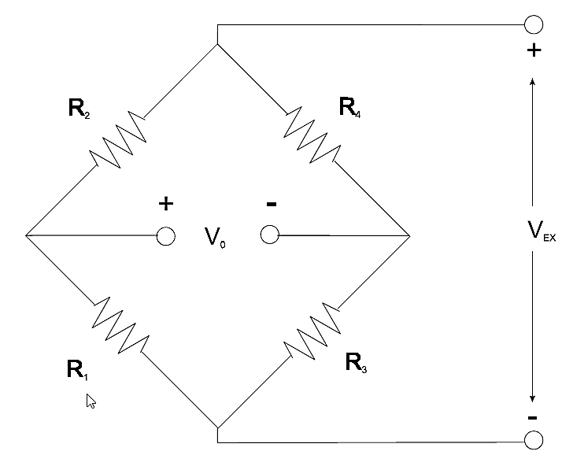
Wheatstone bridges
Due to its sensitivity, the Wheatstone bridge circuit is a commonly used circuit for the measurement of small changes in electrical resistance
It comprises four resistive elements and can be excited by either a voltage or current source
Can still be used to measure very low values of resistances down in the milli-Ohms range
Standard Wheatstone bridge configuration
© 2017 Pearson Education, Ltd., All rights reserved. compiled by Dr. Osama Hosameldeen

Slide 23
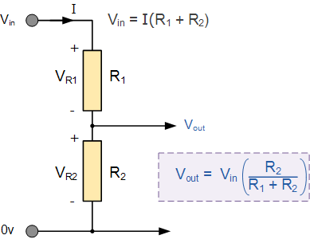
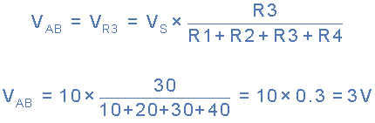
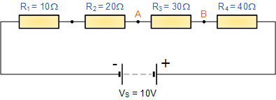
Wheatstone bridges
Voltage Divider Network
  V_{out} is taken from across resistor R₂. The value of this output voltage is given by the corresponding formula.
© 2017 Pearson Education, Ltd., All rights reserved. compiled by Dr. Osama Hosameldeen

Slide 24
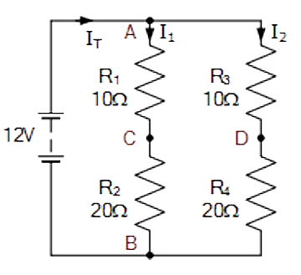
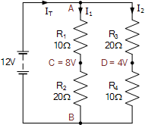
Wheatstone bridges
Voltage Divider Network
  The voltage difference between point C and point D will be zero volts as both points are at the same value of 8 volts as: C = D = 8 volts, then the voltage difference is: 0 volts (balanced)
  With resistors, R3 and R4 reversed (unbalanced ), the voltage difference between points C and D will be 4 volts as: C = 8 volts and D = 4 volts. Then the difference this time is: 8 – 4 = 4 volts
  Then we can see that the resistance ratio of these two parallel arms, ACB and ADB, results in a voltage difference between 0 volts (balanced) and the maximum supply voltage (unbalanced)
balanced
unbalanced
© 2017 Pearson Education, Ltd., All rights reserved. compiled by Dr. Osama Hosameldeen

Slide 25
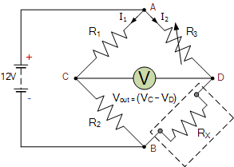
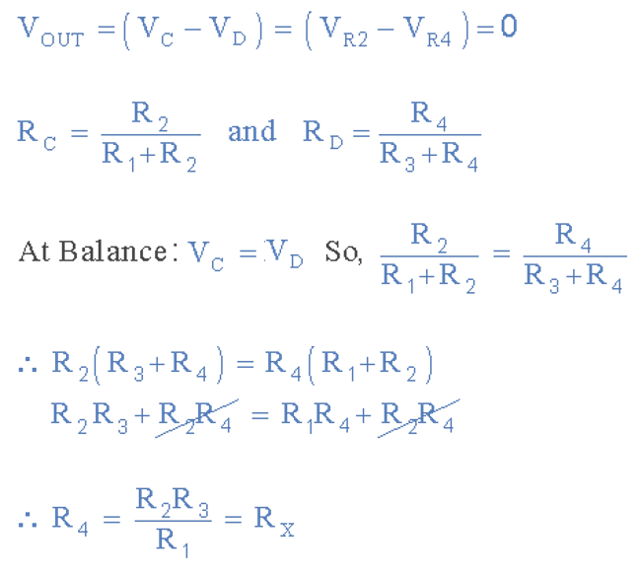
Wheatstone bridges
Wheatstone bridge
  By replacing R₄ above with a resistance of known or unknown value in the sensing arm of the Wheatstone bridge corresponding to R_{X} and adjusting the opposing resistor, R₃ to “balance” the bridge network, will result in a zero-voltage output. Then we can see that balance occurs when:

Slide 26
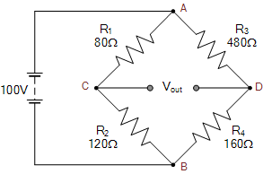
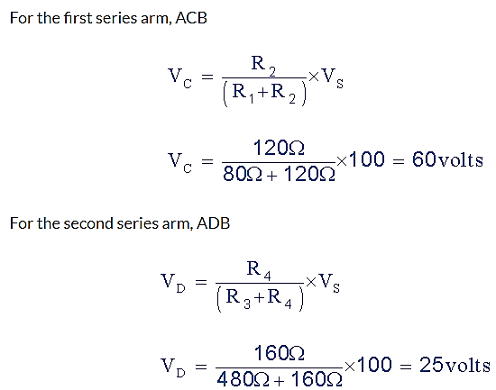
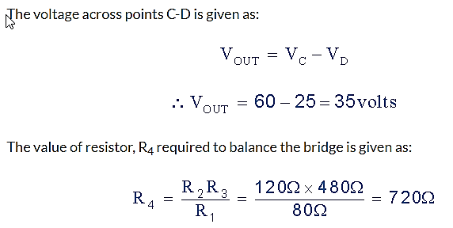
Wheatstone bridges
Wheatstone bridge - Example
  The following unbalanced Wheatstone Bridge is constructed. Calculate the output voltage across points C and D and the value of resistor R₄ required to balance the bridge circuit.

Slide 27
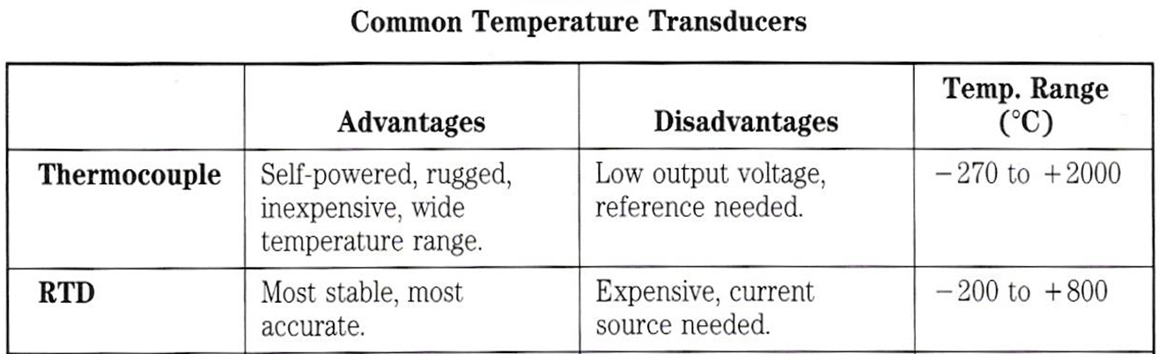
Sensors and Transducers
Temperature Sensors

Slide 28
Thermocouples
© 2017 Pearson Education, Ltd., All rights reserved. compiled by Dr. Osama Hosameldeen

Slide 29
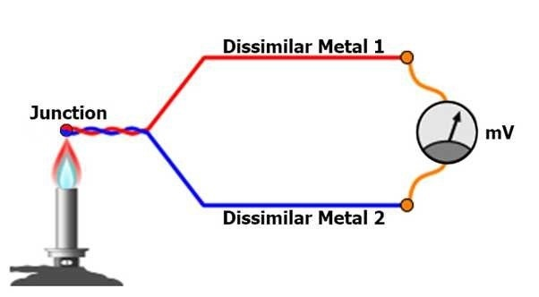
Sensors and Transducers
Temperature Sensors
  Thermocouple
    Operation
      When wires made of dissimilar metals are
        Welded together at both ends
        With different temperatures at both ends
      Current flows

Slide 30
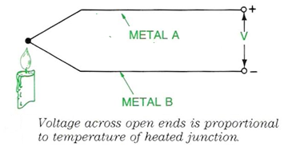

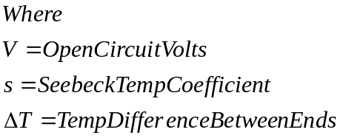
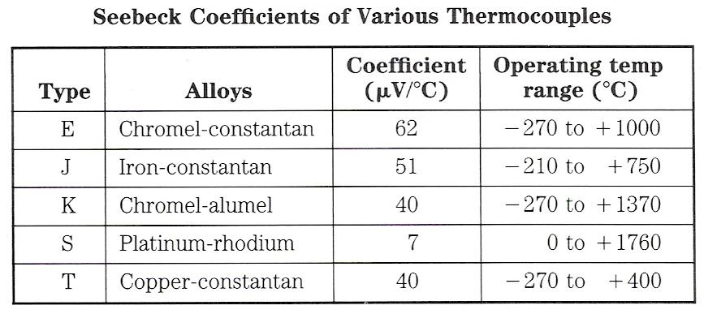
Sensors and Transducers
Temperature Sensors
  Thermocouple
    Operation
      Open the pair of wires in
      between the two ends a
      voltage develops
        Called Seebeck Voltage
        Proportional to
        temperature difference

Slide 31
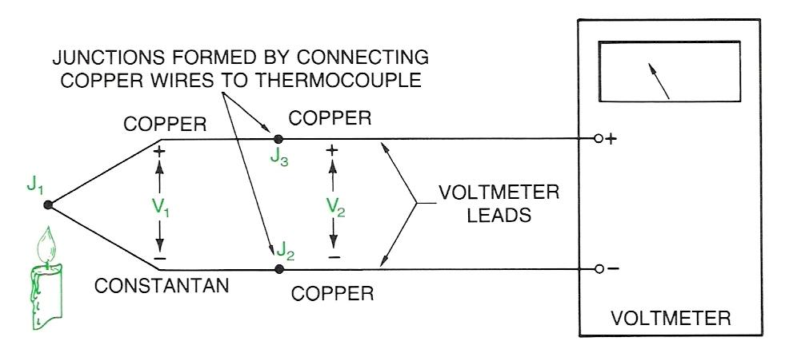
Sensors and Transducers
Temperature Sensors
  Thermocouple
    Operation
      Equation is linear over only a small range of temperatures
      Tables of corrected voltages in 1⁰ increments is available
    Reference Junction
      Voltage developed is dependent upon the temperature difference between ends – NOT Absolute Temperature of the welded end
      It’s at room temp
      Voltage will be wrong
      Need a 0⁰C ref

Slide 32
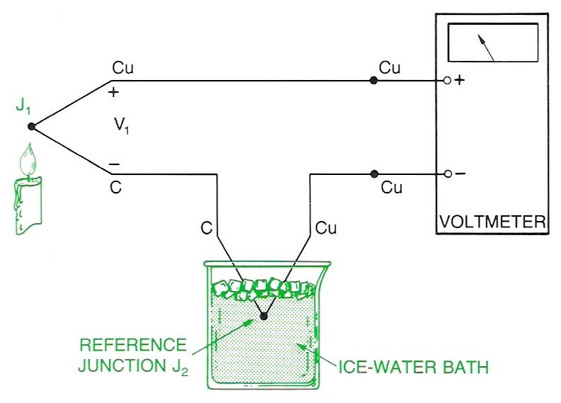
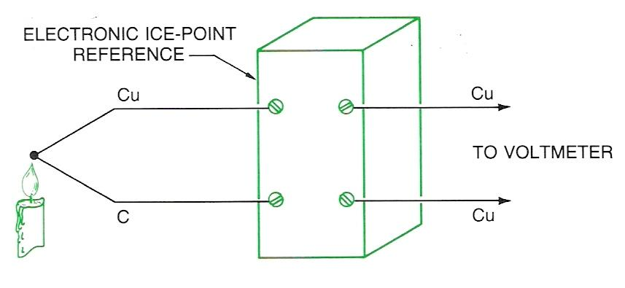
Sensors and Transducers
Temperature Sensors
  Thermocouple
    Reference Junction
      Lab Set up
        Not practical for most situations
    Practical Reference Junction
    solutions
      Electronic Ice points
        Available for All types
        of thermocouples
        Encased electronic device
        that balances an internal bridge
        circuit which generates a voltage to cancel out effect that
        the measurement end isn’t at 0^{O}C

Slide 33
Resistance Temperature Device (RTD)
© 2017 Pearson Education, Ltd., All rights reserved. compiled by Dr. Osama Hosameldeen

Slide 34
Sensors and Transducers
Temperature Sensors
  Resistance Temperature Device (RTD)
    Key principle
      As the temperature of a resistor increases so does its resistance
      Measure the change in the resistance of a known resistor –calculate the temperature change
        Linear relation ship for smaller changes – See next slide
    Typical construction
      Wire wound resistor in on a ceramic core using platinum wire
        Stable (linear) over a wide range of temperatures
        Temperature coefficient = 0.00385/⁰C
      Typical Values: 10 – several kilo-ohms
      Most common value 100Ω

Slide 35
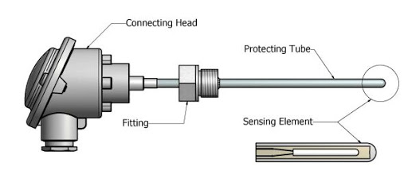
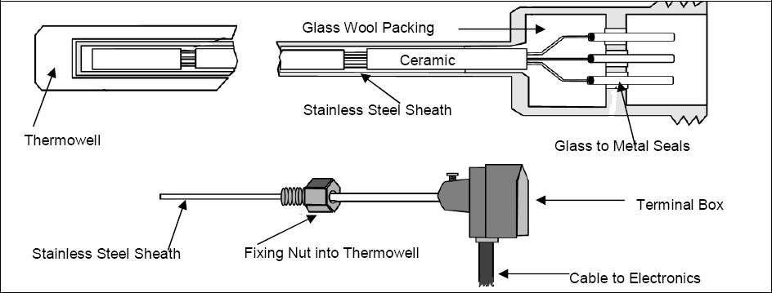
Sensors and Transducers
Temperature Sensors
  Resistance Temperature Device (RTD)

Slide 36
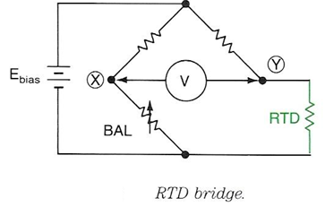
Sensors and Transducers
Temperature Sensors
  Resistance Temperature Device RTD
    Measuring Circuit Types
      RTD Bridge circuit
      Constant Current Source
    RTD Bridge circuit
      Platinum resistor is remote from the bridge circuit which is isolated from the sensing point
      Bridge is balanced at a known temperature
        Eliminates consideration of the connecting leads
      Voltage developed is proportional to the temperature change

Slide 37
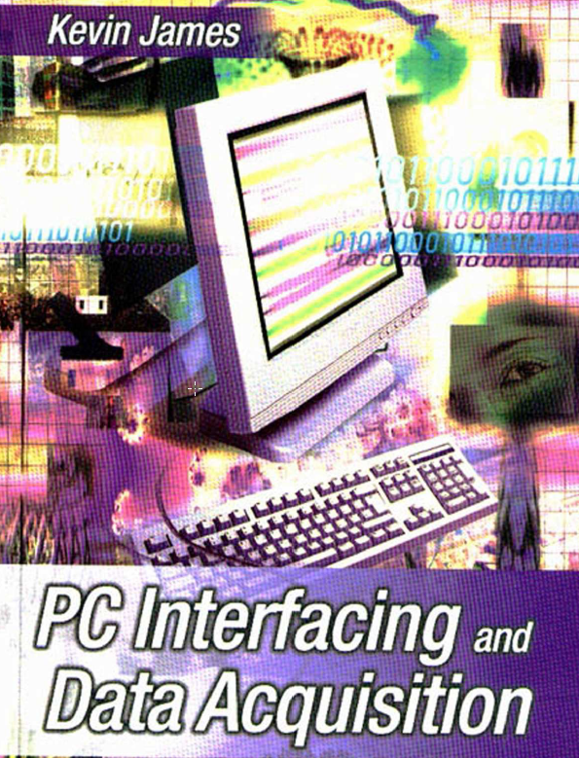
Reference
Kevin James - PC Interfacing and Data Acquisition Techniques for Measurement, Instrumentation and Control. (2000)
Chapter 3,4

